Slide 1
Masonry TOOL IDENTIFICATION

Slide 2
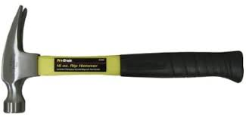
Ripping Hammer

Slide 3
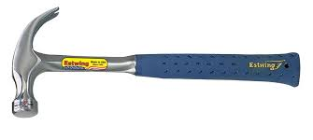
Curved Claw Hammer

Slide 4
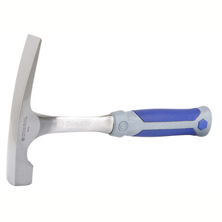
Brick Hammer

Slide 5
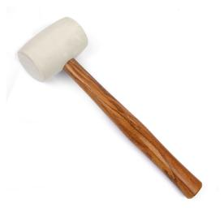
Rubber Mallet

Slide 6
Sledgehammer

Slide 7
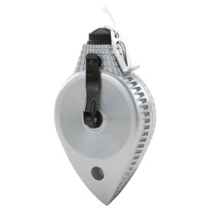
Chalk Line Reel

Slide 8
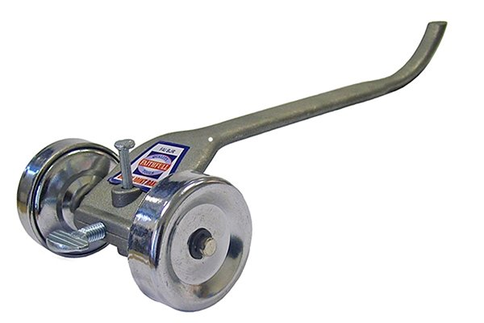
Rake Jointer

Slide 9
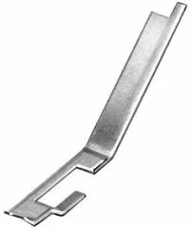
Joint Raker

Slide 10
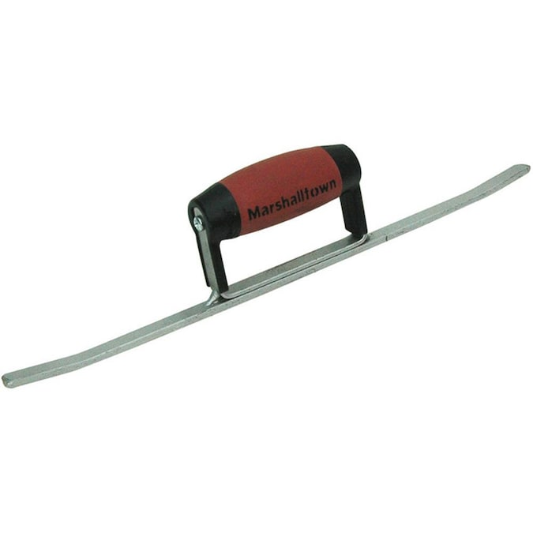
Sled Runner

Slide 11
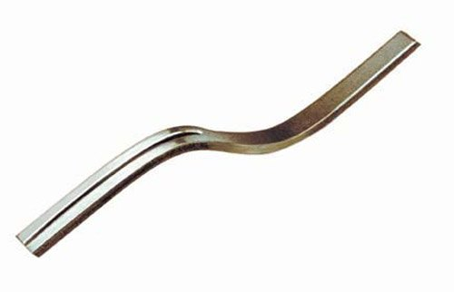
Grapevine Jointer

Slide 12
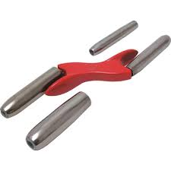
Barrel Jointer

Slide 13
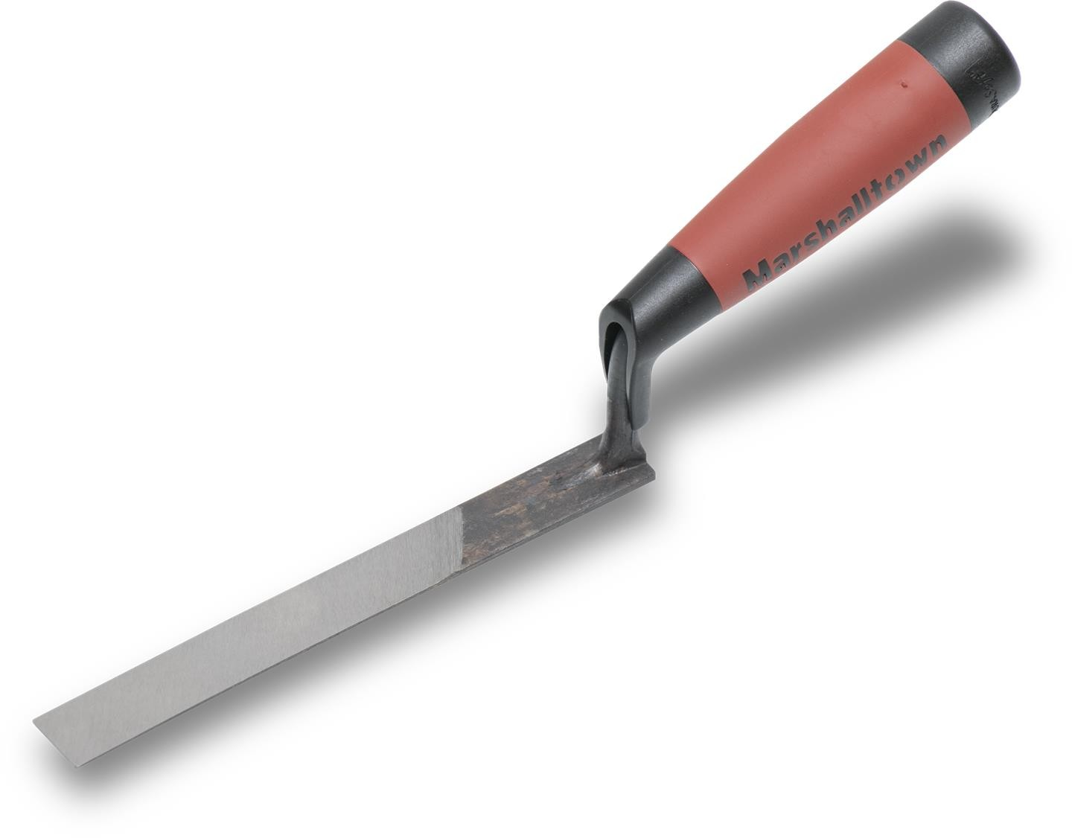
½-inch Brick Jointer

Slide 14
Mason’s Line

Slide 15
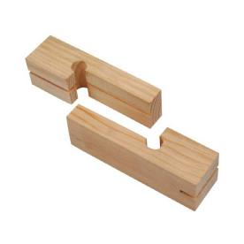
Line Blocks

Slide 16
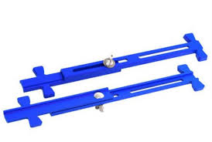
Adjustable Line Stretcher

Slide 17
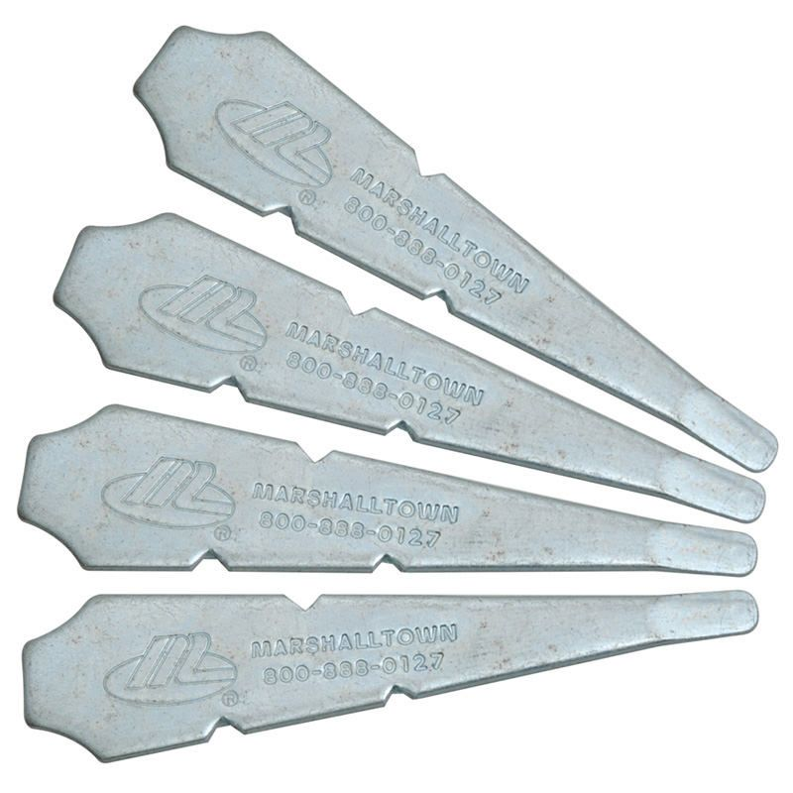
Line Pins

Slide 18
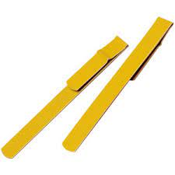
Line Twigs

Slide 19
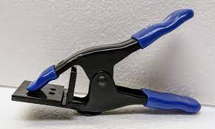
Jag Clamp

Slide 20
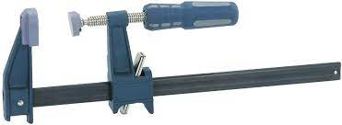
Bar Clamp

Slide 21
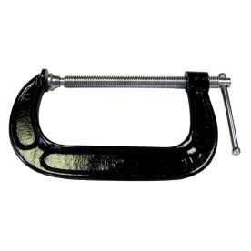
C Clamp

Slide 22
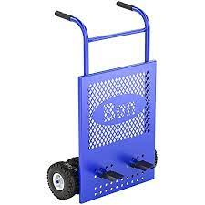
Brick Cart

Slide 23
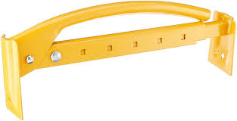
Brick Tongs

Slide 24
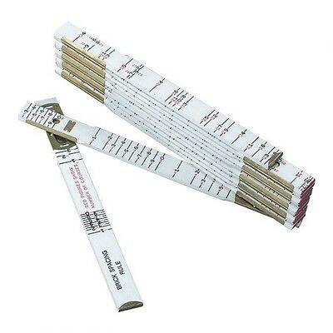
Brick Spacing Rule

Slide 25
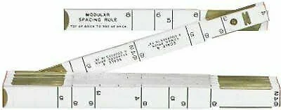
Modular Spacing Rule

Slide 26
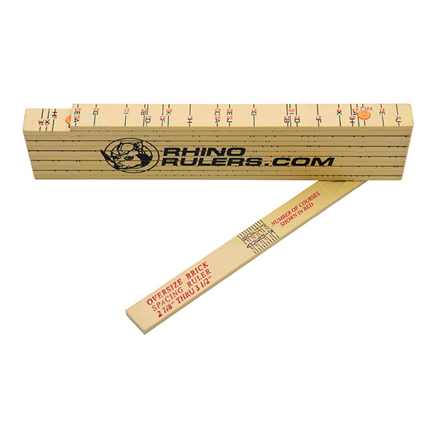
Oversize Brick Spacing Rule

Slide 27
Grout Bag

Slide 28
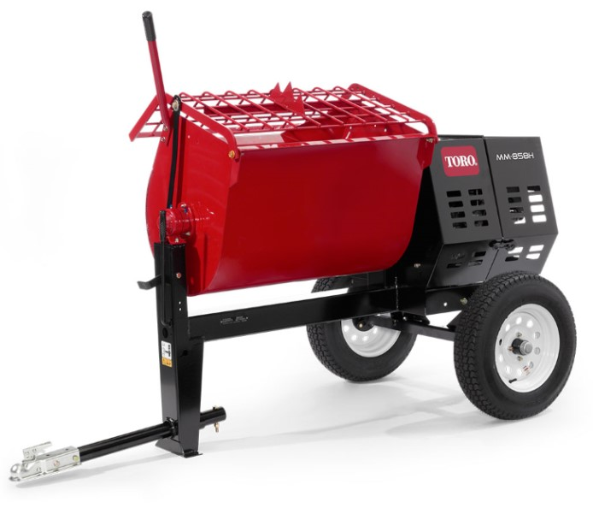
Mortar Mixer

Slide 29
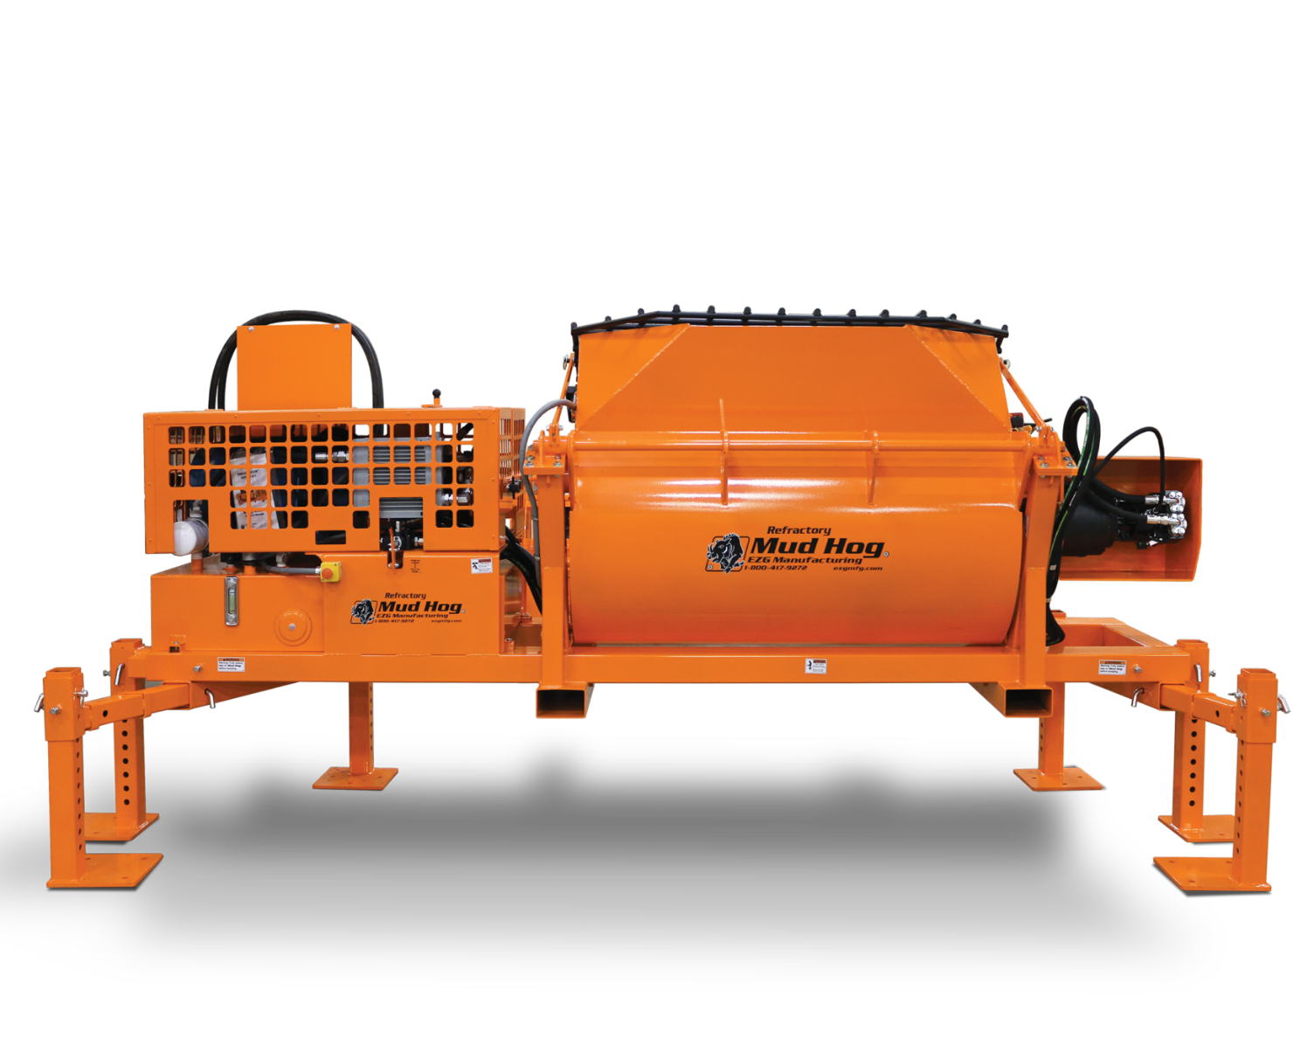
Hydraulic Mixer

Slide 30
5 Gallon Bucket

Slide 31
55 Gallon Drum

Slide 32
Mortar Box

Slide 33
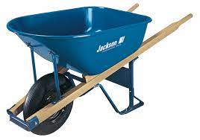
6 Cubic foot Wheelborrow

Slide 34
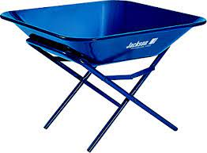
Mortar Pan and Stand

Slide 35
Mortar Tub

Slide 36
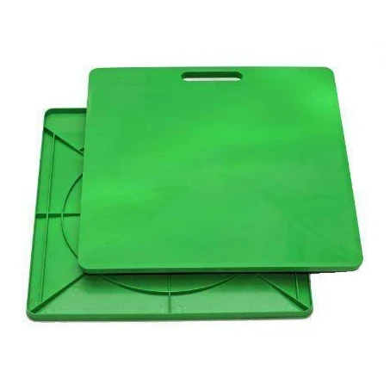
Mortar Board

Slide 37
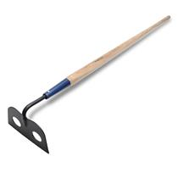
Mortar Hoe

Slide 38
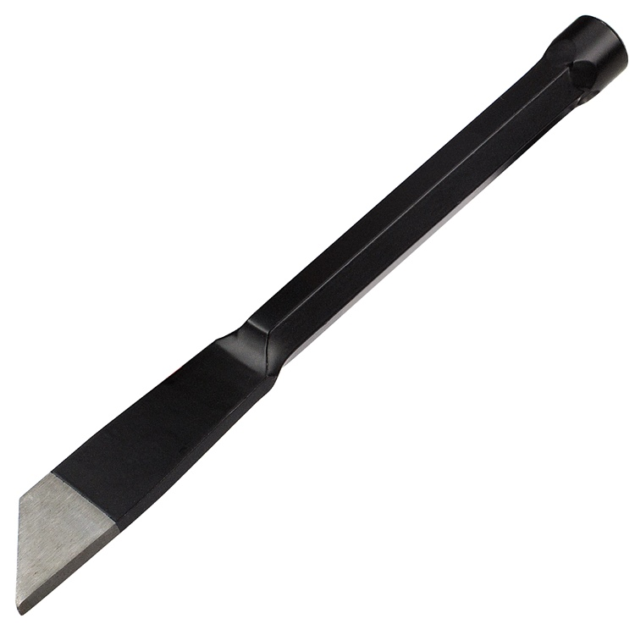
Plugging Chisel

Slide 39
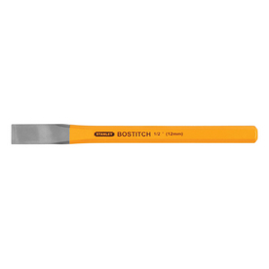
Cold Chisel

Slide 40
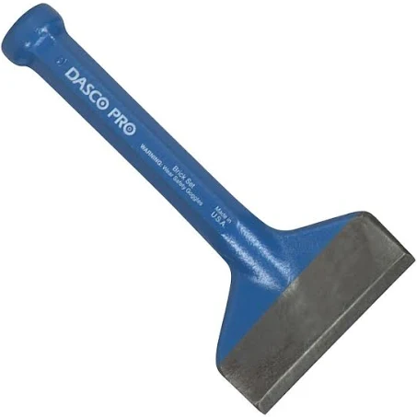
Mason’s Chisel

Slide 41
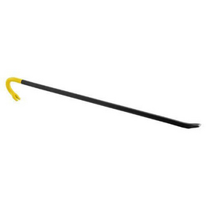
Wrecking Bar

Slide 42
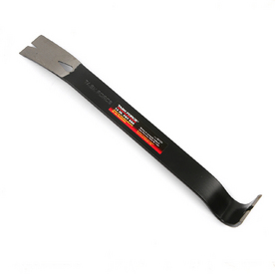
Steel Pry Bar

Slide 43
Skid-Steer

Slide 44
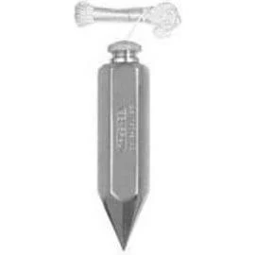
Plumb Bob

Slide 45
5-in-1 Glazing Knife

Slide 46
Rebar Bender and Cutter

Slide 47
Rebar Safety Caps

Slide 48
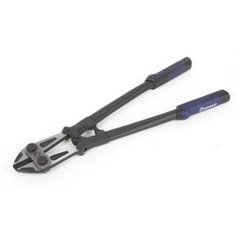
Bolt Cutter

Slide 49
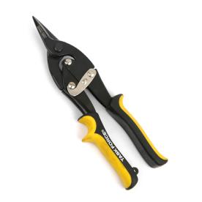
Aviation Tin Snips-Straight Cut

Slide 50
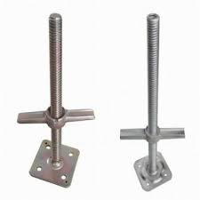
Screw Jacks

Slide 51
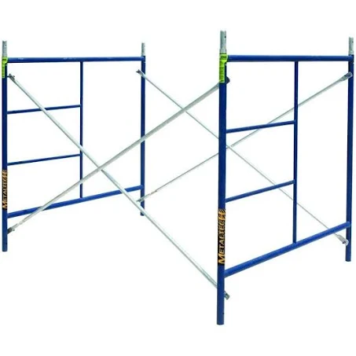
5’ Ladder Scaffolds

Slide 52
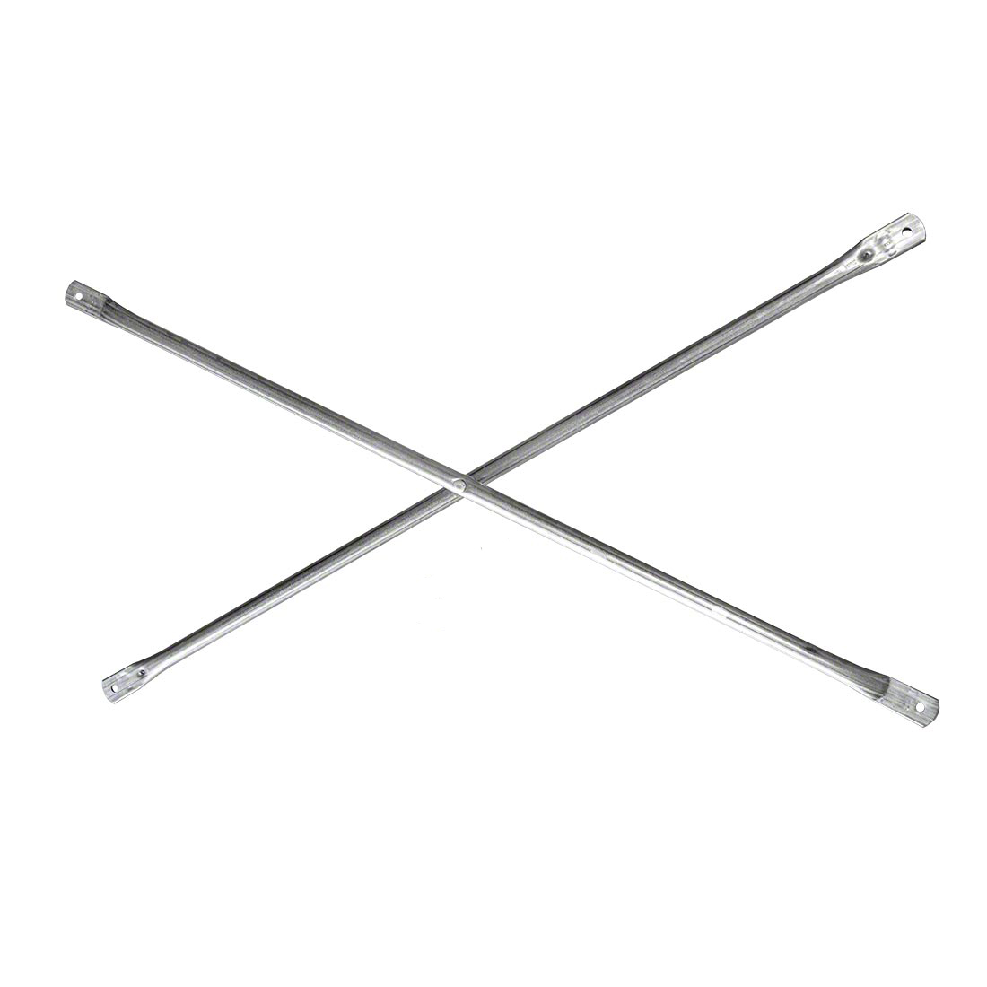
Cross Brace

Slide 53
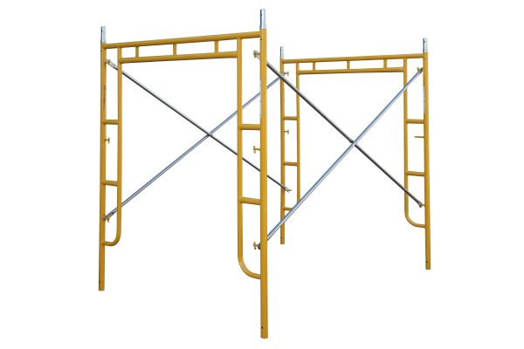
Walk Thru Scaffolds

Slide 54
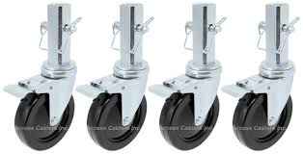
Scaffold Casters

Slide 55
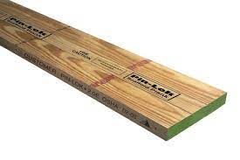
OSHA Scaffold Plank

Slide 56
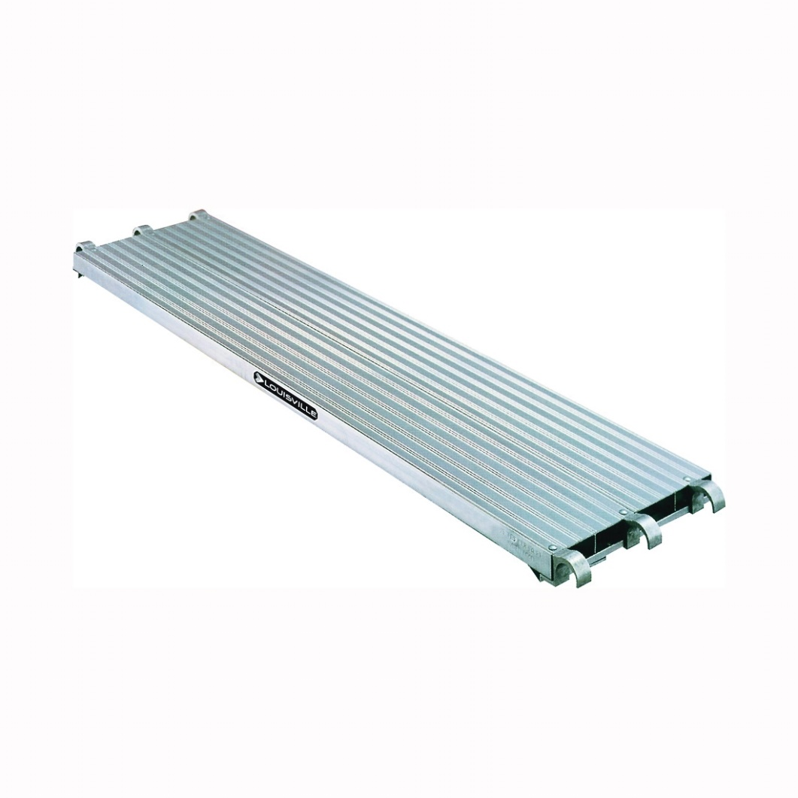
Aluminum Walk Board

Slide 57
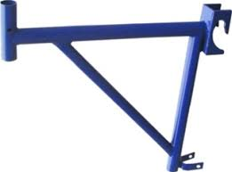
Side Bracket

Slide 58
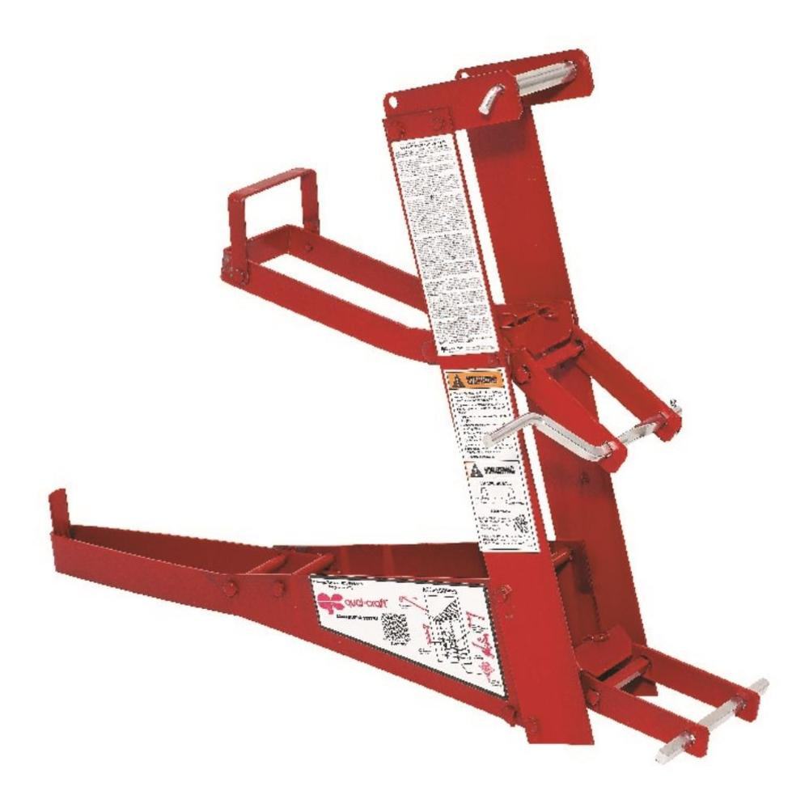
Pump Jack

Slide 59
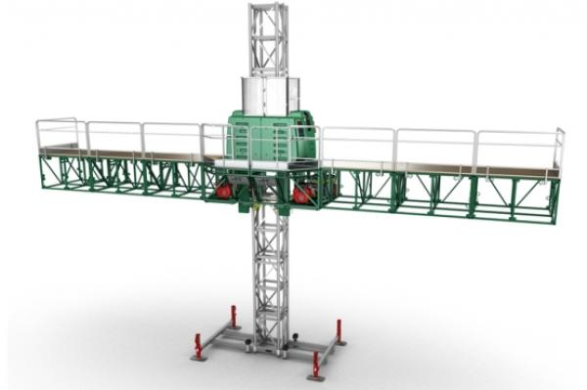
Mast Climbing Work Platform

Slide 60
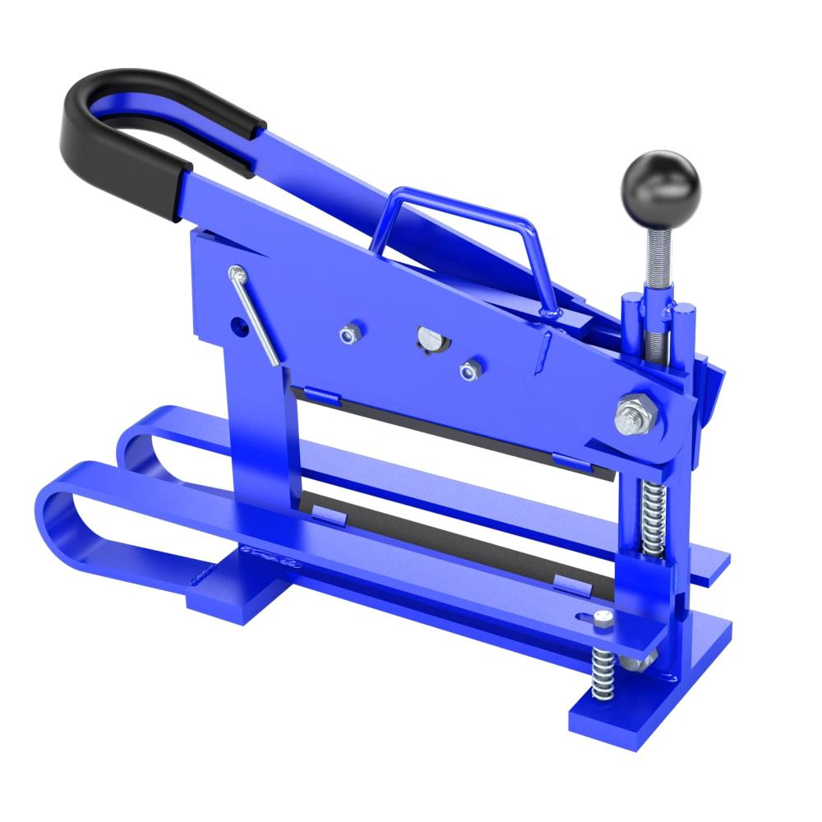
Paver and Brick Buster

Slide 61
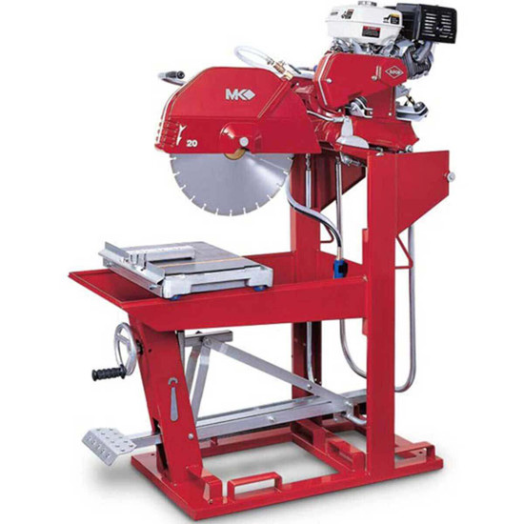
Gas Brick and Block Saw

Slide 62
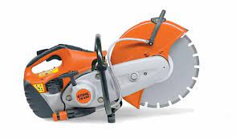
Cut-Off Saw

Slide 63
Diamond Blade

Slide 64
Walk-Behind Concrete Saw

Slide 65
Portable Ban Saw

Slide 66
Margin Trowel

Slide 67
Corner Trowel

Slide 68
Pointing Trowel

Slide 69
Brick Trowel (London)

Slide 70
Brick Trowel (Philadelphia)

Slide 71
Tie Wire Twister

Slide 72
Rub Brick

Slide 73
Masonry Brush

Slide 74
Mason’s Tool Bag

Slide 75
Quoin Corner Bracket

Slide 76
Corner Pole

Slide 77
Inside Corner Bracket

Slide 78
Outside Corner Base

Slide 79
Outside Corner Top

Slide 80
Cut Nails

Slide 81
Fluted Masonry Nails

Slide 82
Masonry Drill Bits

Slide 83
Framing Square

Slide 84
Combination Square

Slide 85
Speed Square

Slide 86
Hand Saw

Slide 87
Hacksaw

Slide 88
Hammer Drill

Slide 89
Cordless Drill

Slide 90
Electric Reciprocating Saw

Slide 91
Electric Circular Saw

Slide 92
Utility Knife

Slide 93
Hook Blade

Slide 94
Razor Blade

Slide 95
Leveling Rod

Slide 96
Laser Detector

Slide 97
Rotary Laser Level

Slide 98
Tripod

Slide 99
Transit

Slide 100
4’ Level

Slide 101
2’ Level

Slide 102
Torpedo Level

Slide 103
Line Level

Slide 104
Tape Measure

Slide 105
Open Reel Tape Measure

Slide 106
Telescopic Forklift

Slide 107
Rough Terrain Forklift

Slide 108
Round Shovel

Slide 109
Flat Shovel

Slide 110
Hand Tamper

Slide 111
Plate Compactor

Slide 112
Concrete Buggy

Slide 113
Come Along Rake

Slide 114
Concrete Edger

Slide 115
Concrete Groover

Slide 116
Concrete Threaded Handles

Slide 117
Concrete Float

Slide 118
Concrete Finishing Trowel

Slide 119
Hand Concrete Float

Slide 120
Hand Finishing Trowel

Slide 121
Concrete Power Trowel

Slide 122
Ride-On-Trowel Machine

Slide 123
Scraper

Slide 124
4” Angle Grinder

Slide 125
Machinist’s Vise

Slide 126
Carpenter’s Pencil

