Slide 1

Masonry TOOL IDENTIFICATION

Slide 2
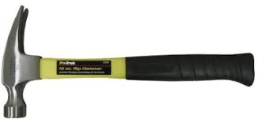
Ripping Hammer

Slide 3
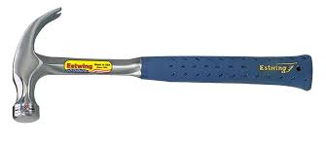
Curved Claw Hammer

Slide 4
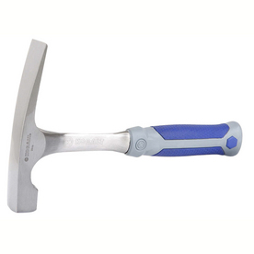
Brick Hammer

Slide 5
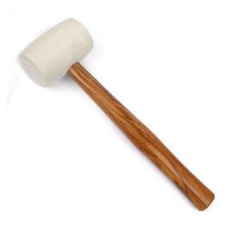
Rubber Mallet

Slide 6
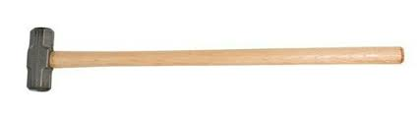
Sledgehammer

Slide 7
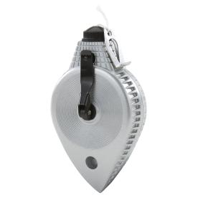
Chalk Line Reel

Slide 8
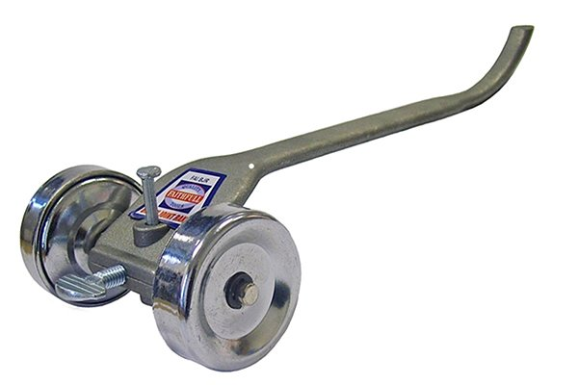
Rake Jointer

Slide 9
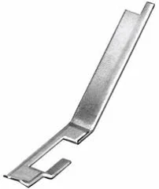
Joint Raker

Slide 10
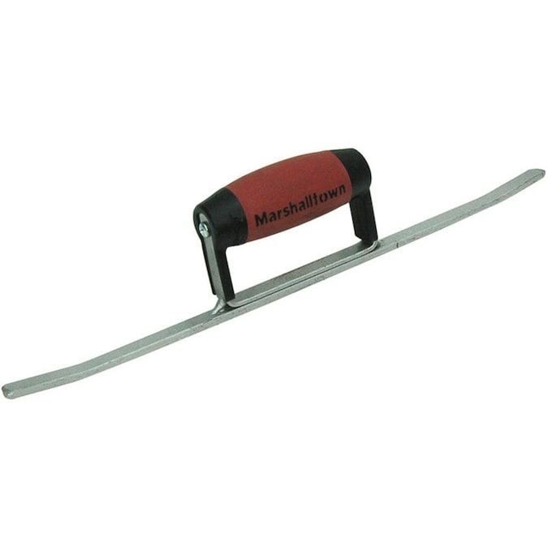
Sled Runner

Slide 11
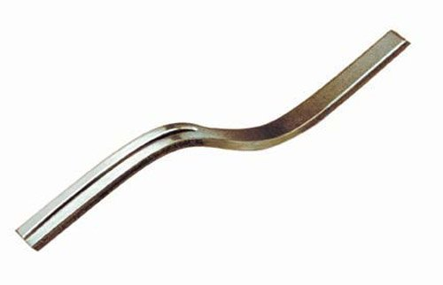
Grapevine Jointer

Slide 12
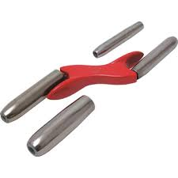
Barrel Jointer

Slide 13
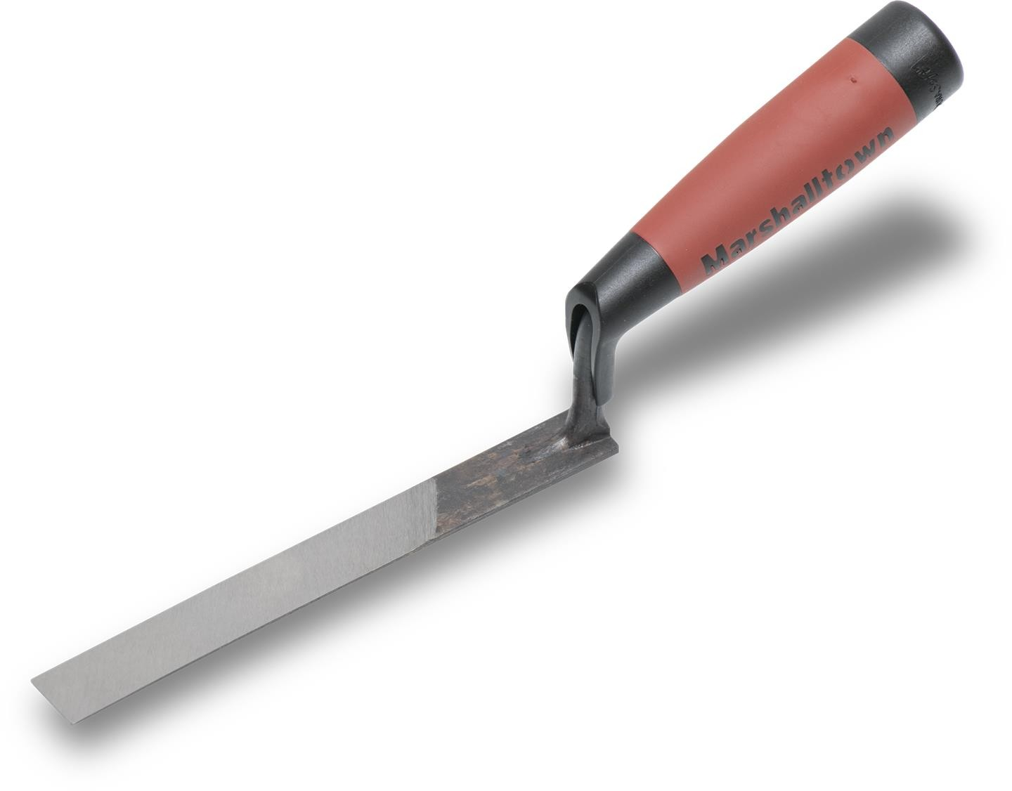
½-inch Brick Jointer

Slide 14

Mason’s Line

Slide 15
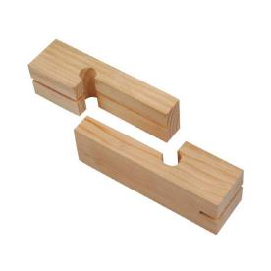
Line Blocks

Slide 16
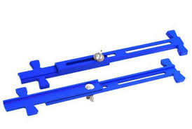
Adjustable Line Stretcher

Slide 17
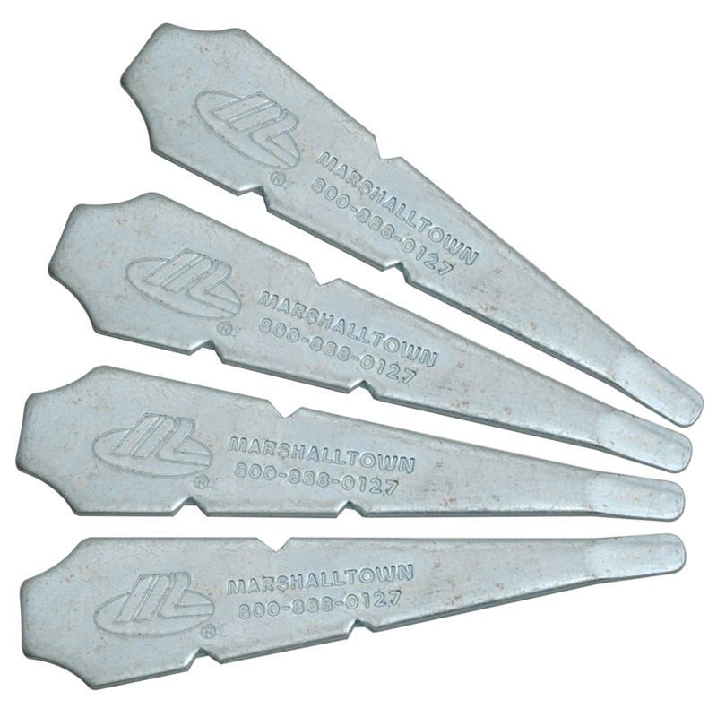
Line Pins

Slide 18
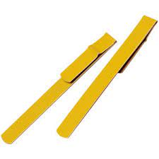
Line Twigs

Slide 19
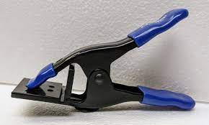
Jag Clamp

Slide 20
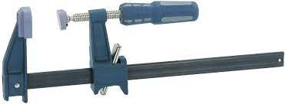
Bar Clamp

Slide 21
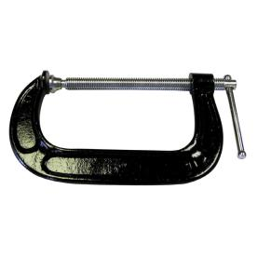
C Clamp

Slide 22
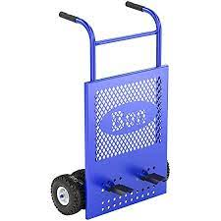
Brick Cart

Slide 23
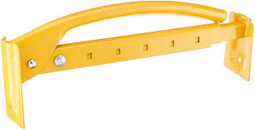
Brick Tongs

Slide 24
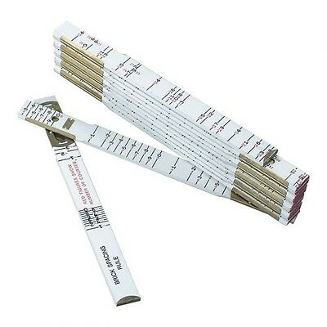
Brick Spacing Rule

Slide 25
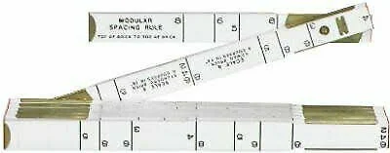
Modular Spacing Rule

Slide 26
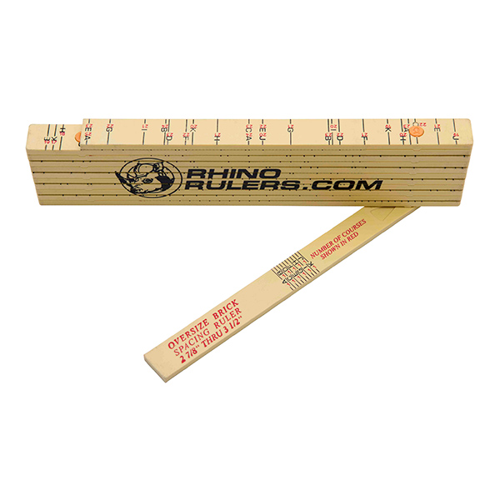
Oversize Brick Spacing Rule

Slide 27

Grout Bag

Slide 28
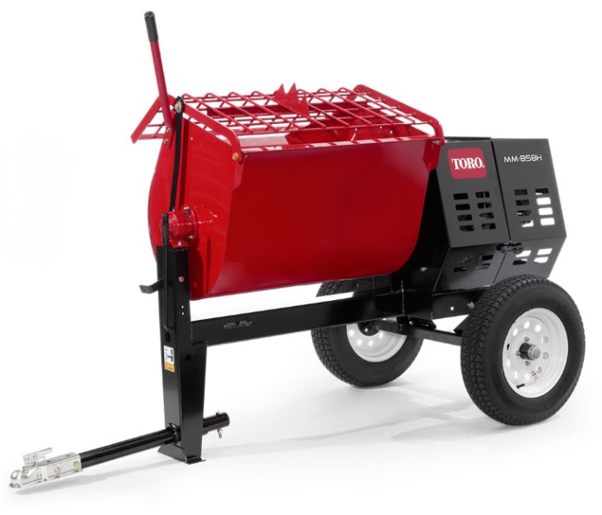
Mortar Mixer

Slide 29
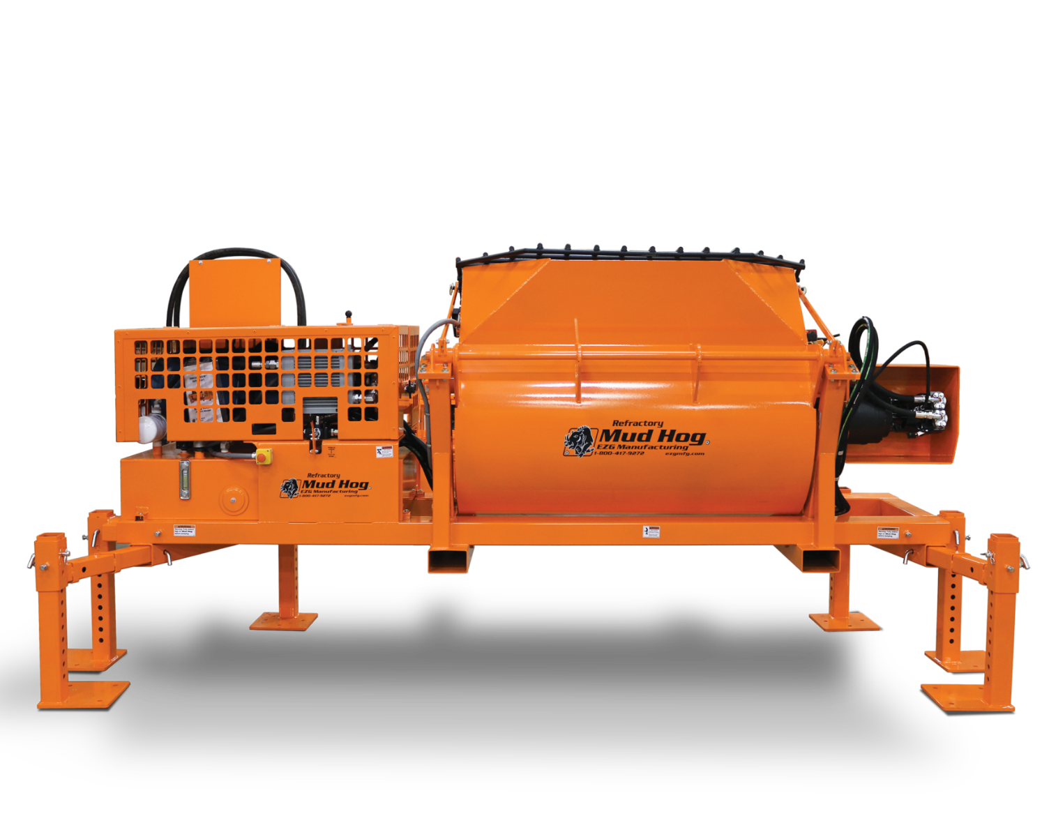
Hydraulic Mixer

Slide 30

5 Gallon Bucket

Slide 31

55 Gallon Drum

Slide 32

Mortar Box

Slide 33
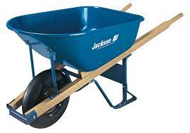
6 Cubic foot Wheelbarrow

Slide 34
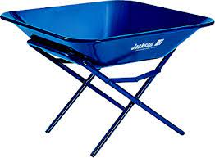
Mortar Pan and Stand

Slide 35
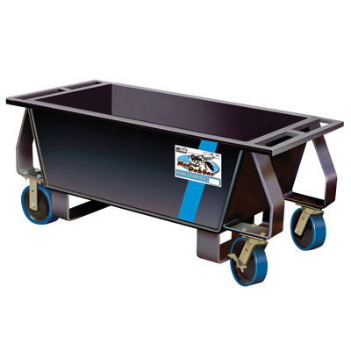
Mortar Tub

Slide 36
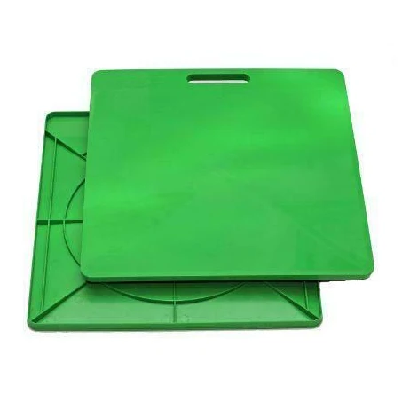
Mortar Board

Slide 37
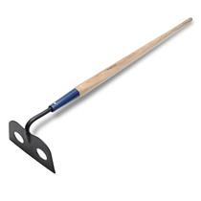
Mortar Hoe

Slide 38
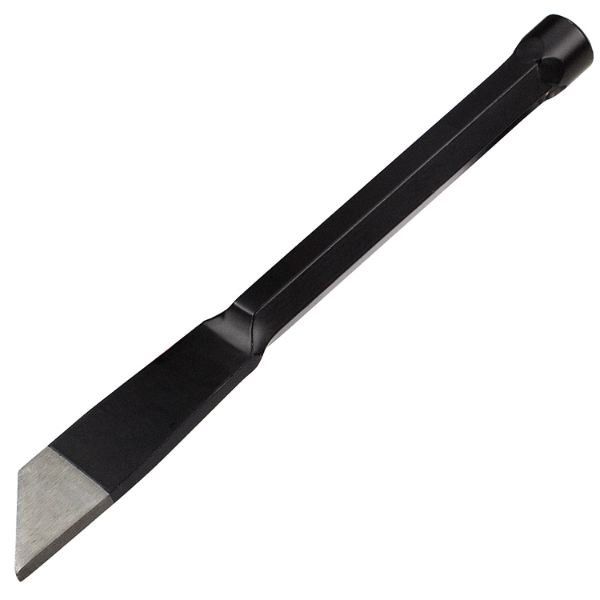
Plugging Chisel

Slide 39
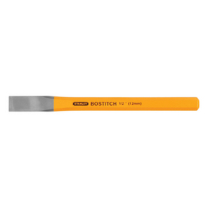
Cold Chisel

Slide 40
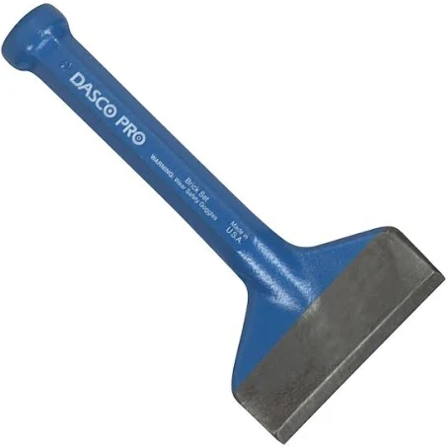
Mason’s Chisel

Slide 41
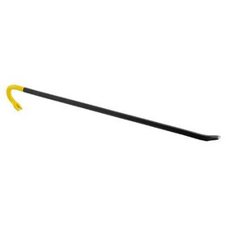
Wrecking Bar

Slide 42
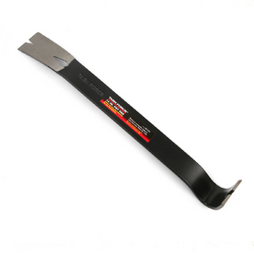
Steel Pry Bar

Slide 43

Skid-Steer

Slide 44
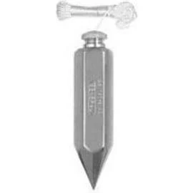
Plumb Bob

Slide 45

5-in-1 Glazing Knife

Slide 46
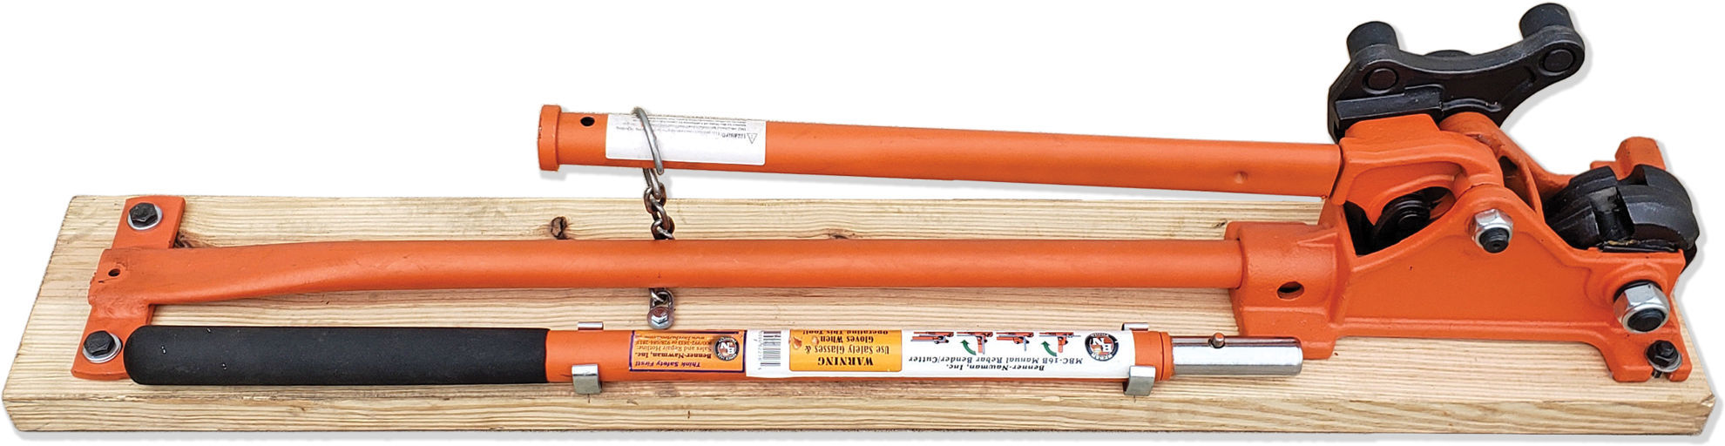
Rebar Bender and Cutter

Slide 47

Rebar Safety Caps

Slide 48
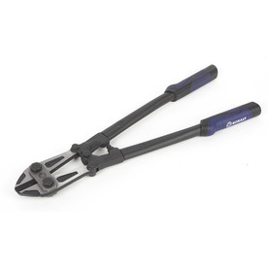
Bolt Cutter

Slide 49
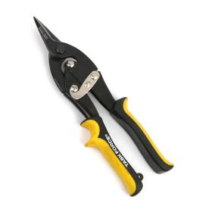
Aviation Tin Snips-Straight Cut

Slide 50
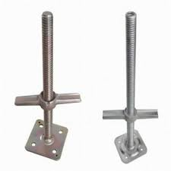
Screw Jacks

Slide 51
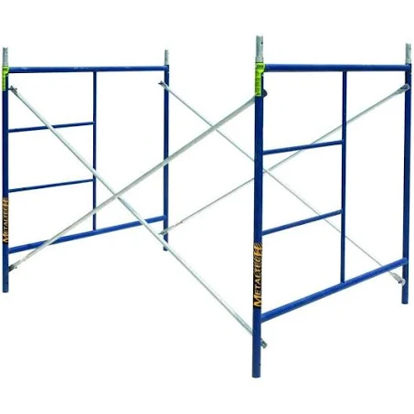
5’ Ladder Scaffolds

Slide 52
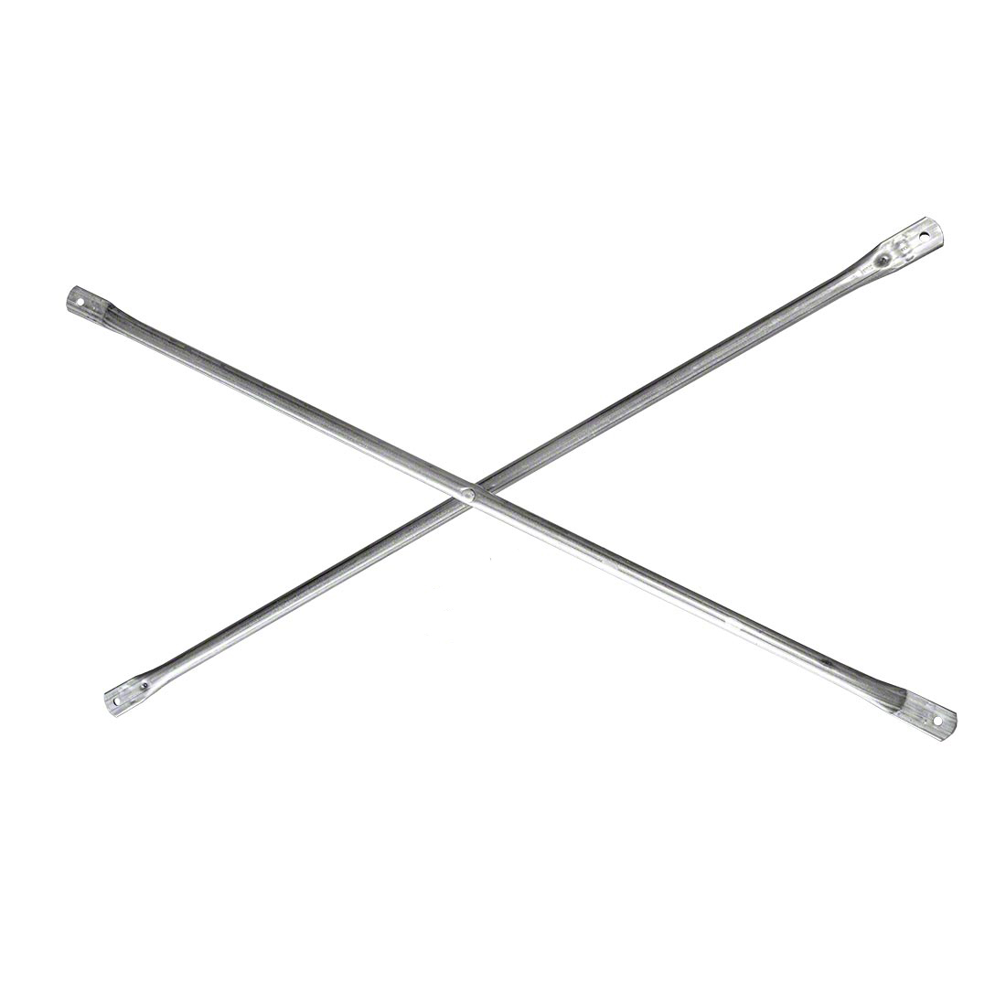
Cross Brace

Slide 53
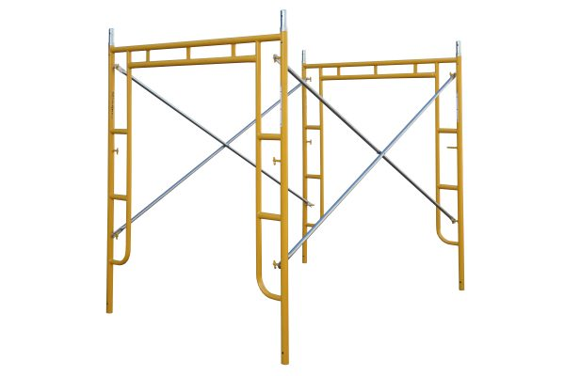
Walk Thru Scaffolds

Slide 54
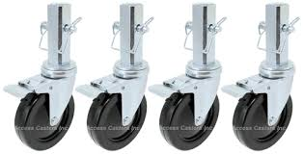
Scaffold Casters

Slide 55
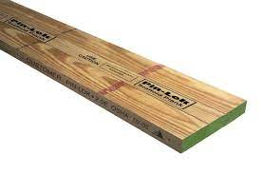
OSHA Scaffold Plank

Slide 56
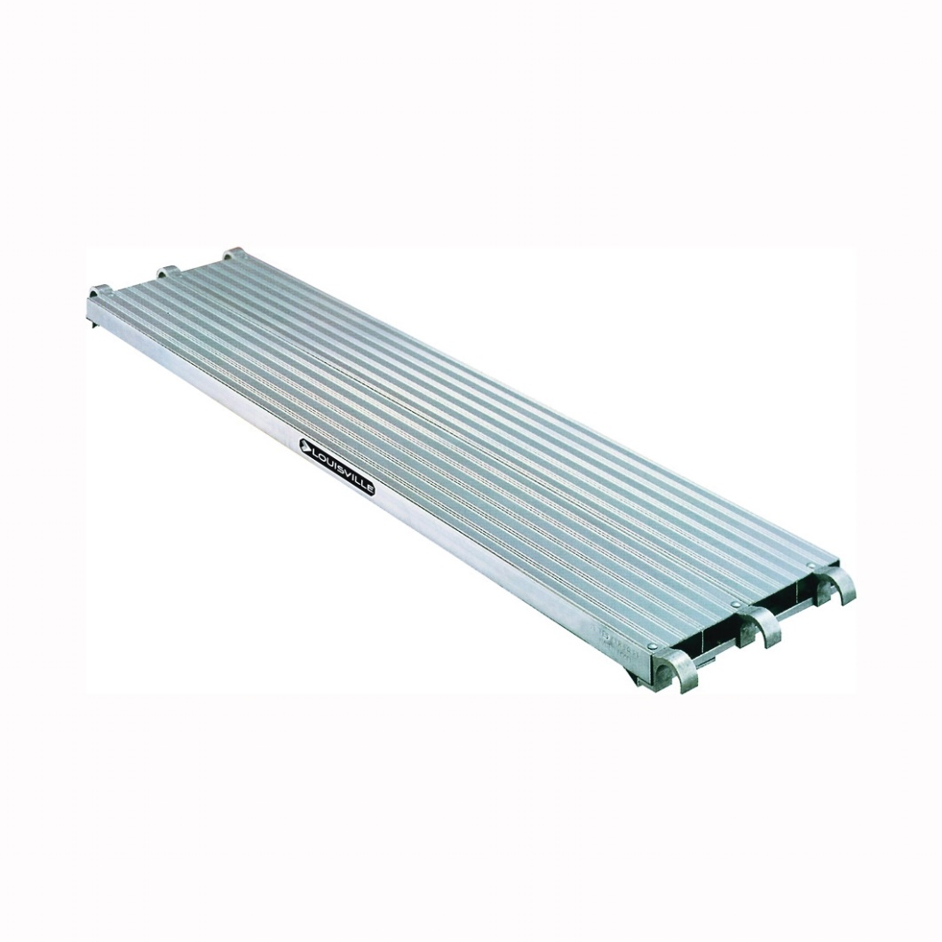
Aluminum Walk Board

Slide 57
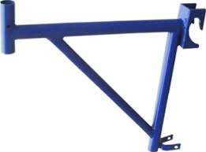
Side Bracket

Slide 58
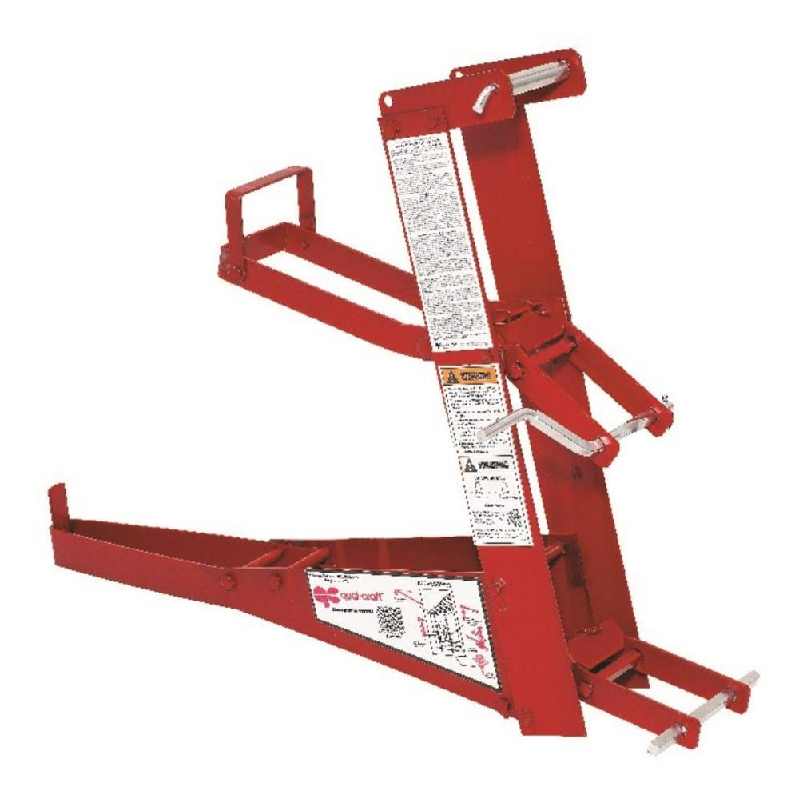
Pump Jack

Slide 59
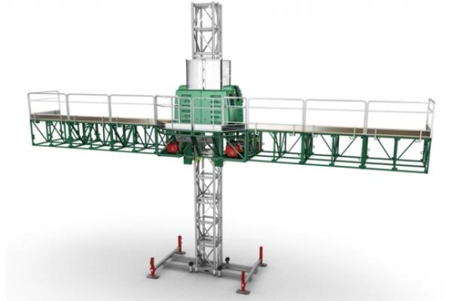
Mast Climbing Work Platform

Slide 60

Paver and Brick Buster

Slide 61

Gas Brick and Block Saw

Slide 62

Cut-Off Saw

Slide 63

Diamond Blade

Slide 64

Walk-Behind Concrete Saw

Slide 65

Portable Ban Saw

Slide 66

Margin Trowel

Slide 67

Corner Trowel

Slide 68

Pointing Trowel

Slide 69

Brick Trowel (London)

Slide 70

Brick Trowel (Philadelphia)

Slide 71

Tie Wire Twister

Slide 72

Rub Brick

Slide 73

Masonry Brush

Slide 74

Mason’s Tool Bag

Slide 75

Quoin Corner Bracket

Slide 76

Corner Pole

Slide 77

Inside Corner Bracket

Slide 78

Outside Corner Base

Slide 79

Outside Corner Top

Slide 80

Cut Nails

Slide 81

Fluted Masonry Nails

Slide 82

Masonry Drill Bits

Slide 83

Framing Square

Slide 84

Combination Square

Slide 85

Speed Square

Slide 86

Hand Saw

Slide 87

Hacksaw

Slide 88

Hammer Drill

Slide 89

Cordless Drill

Slide 90

Electric Reciprocating Saw

Slide 91

Electric Circular Saw

Slide 92

Utility Knife

Slide 93

Hook Blade

Slide 94

Razor Blade

Slide 95

Leveling Rod

Slide 96

Laser Detector

Slide 97

Rotary Laser Level

Slide 98

Tripod

Slide 99

Transit

Slide 100

4’ Level

Slide 101

2’ Level

Slide 102

Torpedo Level

Slide 103

Line Level

Slide 104

Tape Measure

Slide 105

Open Reel Tape Measure

Slide 106

Telescopic Forklift

Slide 107

Rough Terrain Forklift

Slide 108

Round Shovel

Slide 109

Flat Shovel

Slide 110

Hand Tamper

Slide 111

Plate Compactor

Slide 112

Concrete Buggy

Slide 113

Come Along Rake

Slide 114

Concrete Edger

Slide 115

Concrete Groover

Slide 116

Concrete Threaded Handles

Slide 117

Concrete Float

Slide 118

Concrete Finishing Trowel

Slide 119

Hand Concrete Float

Slide 120

Hand Finishing Trowel

Slide 121

Concrete Power Trowel

Slide 122

Ride-On-Trowel Machine

Slide 123

Scraper

Slide 124

4” Angle Grinder

Slide 125

Machinist’s Vise

Slide 126

Carpenter’s Pencil

