Slide 1
AUTOMOTIVE TOOL IDENTIFICATION

Slide 2
Brake Adjuster
1

Slide 3
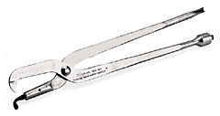
Brake Spring Pliers
2

Slide 4
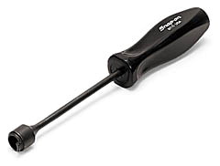
Brake Spring Tool
3

Slide 5
Brake Petal Jack
4

Slide 6
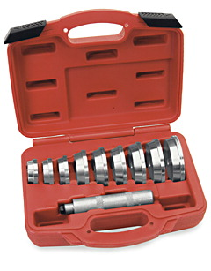
Bearing Seal and Race Driver Set
5

Slide 7
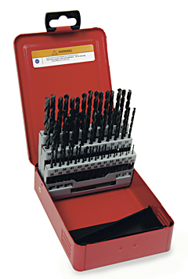
Twist Drill Set
6

Slide 8
Trouble / Work Light
7

Slide 9
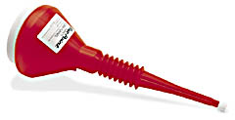
Funnel
8

Slide 10
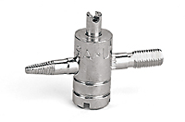
Valve Core Removing Tool
9

Slide 11
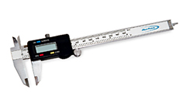
Calipers
10

Slide 12
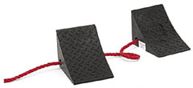
Wheel Chocks
11

Slide 13
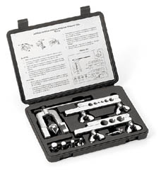
Flaring Tool Set
12

Slide 14
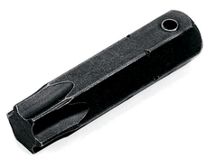
Torx Bit
13

Slide 15
Tap & Die Set
14

Slide 16
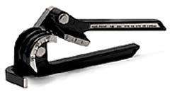
Tubing Bender
15

Slide 17
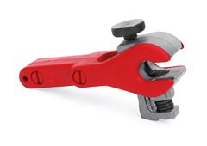
Tubing Cutter
16

Slide 18
Diagonal Cutter Pliers
17

Slide 19
Combination Slip-Joint Pliers
18

Slide 20
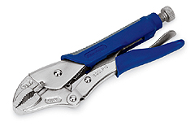
Locking Pliers
19

Slide 21
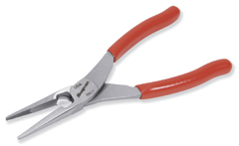
Needle Nose Pliers
20

Slide 22
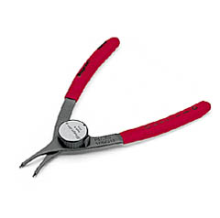
Retaining Ring Pliers
21

Slide 23
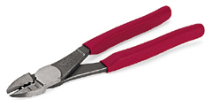
Terminal Crimping Pliers
22

Slide 24
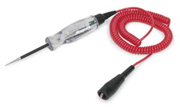
Test Light
23

Slide 25
Digital Brake Drum Gauge
24

Slide 26
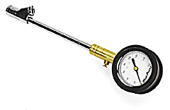
Tire Pressure Gauge
25

Slide 27
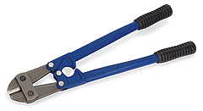
Bolt Cutters
26

Slide 28
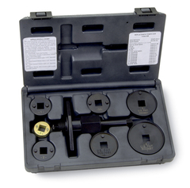
Brake Caliper Tool Set
27

Slide 29
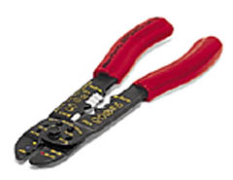
Wire Stripper
28

Slide 30
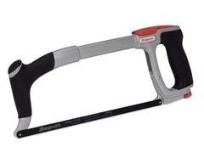
Hacksaw
29

Slide 31
Utility Knife
30

Slide 32
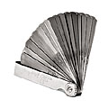
Feeler Gauge
31

Slide 33
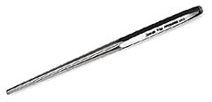
Drift Pin Punch
32

Slide 34
Flat Chisel
33

Slide 35
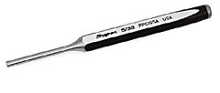
Pin Punch
34

Slide 36
Sliding T-Handle
35

Slide 37
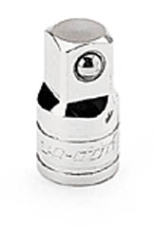
Adaptor
36

Slide 38
Universal Joint
37

Slide 39
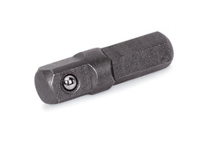
Hex-to-Square Adaptor
38

Slide 40
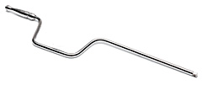
Speeder
39

Slide 41
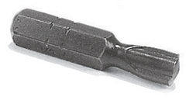
Clutch Bit
40

Slide 42
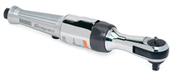
Air Ratchet
41

Slide 43
Hex-to-Square Adaptor
42

Slide 44
Flathead Screwdriver
43

Slide 45
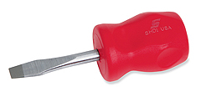
Stubby Flathead Screwdriver
44

Slide 46
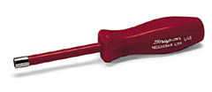
Nut Driver
45

Slide 47
Phillips Screwdriver
46

Slide 48
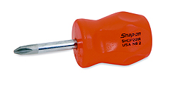
Stubby Phillips Screwdriver
47

Slide 49
Putty Knife
48

Slide 50
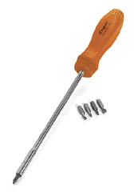
Ratcheting Screwdriver
49

Slide 51
TORX Screwdriver
50

Slide 52
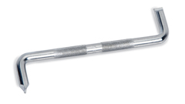
Offset Flat Tip Screwdriver
51

Slide 53
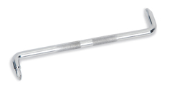
Offset Phillips Screwdriver
52

Slide 54
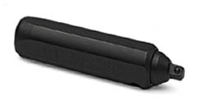
Impact Driver
53

Slide 55
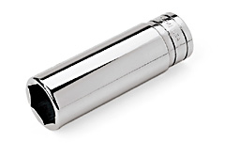
6-Point Deep Socket
54

Slide 56
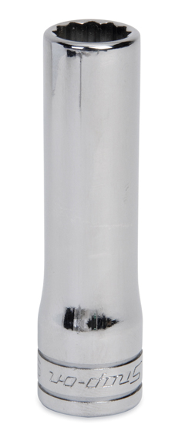
12-Point Deep Socket
55

Slide 57
12-Point Socket
56

Slide 58
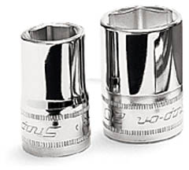
6-Point Socket
57

Slide 59
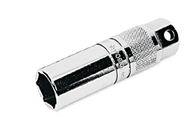
Spark Plug Socket
58

Slide 60
Socket Extension
59

Slide 61
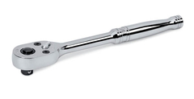
Ratchet
60

Slide 62
Breaker Bar
61

Slide 63
Flex head Ratchet
62

Slide 64
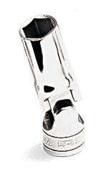
Flexible Socket
63

Slide 65
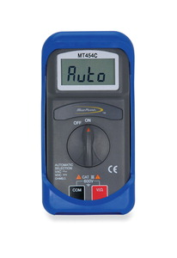
Digital Multimeter
64

Slide 66
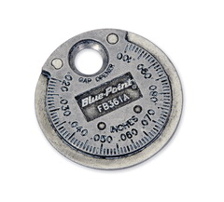
Spark Plug Gap Tool
65

Slide 67
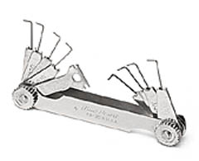
Spark Plug Feeler Gauge
66

Slide 68
Torque Wrench
67

Slide 69
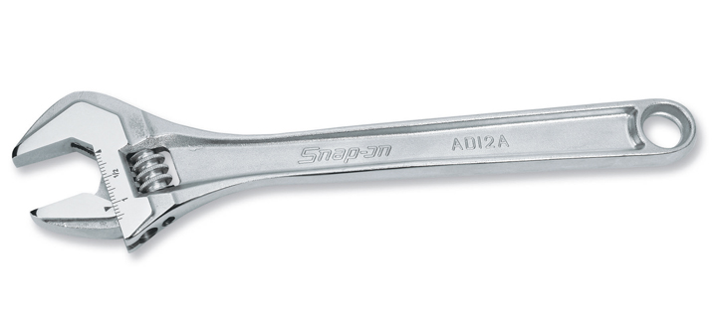
Adjustable Wrench
68

Slide 70
Boxed End Offset Wrench
69

Slide 71
Chain Wrench
70

Slide 72
Flare Nut Wrench
71

Slide 73
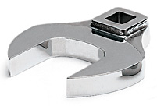
Crowfoot Wrench
72

Slide 74
Rolling Head Pry Bar
73

Slide 75
Straight Pry Bar
74

Slide 76
Center Punch
75

Slide 77
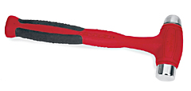
Dead Blow Hammer
76

Slide 78
Ball Peen Hammer
77

Slide 79
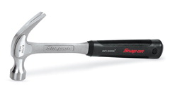
Claw Hammer
78

Slide 80
Sledge Hammer
79

Slide 81
Brass Drift Punch
80

Slide 82
Taper Punch
81

Slide 83
Carbon Scraper
82

Slide 84
Gasket Scraper
83

Slide 85
Tape Measure
84

Slide 86
Tread Depth Gauge
85

Slide 87
Wire Brush
86

Slide 88
Allen Wrench
87

Slide 89
Battery Post Cleaner
88

Slide 90
Battery Terminal Puller
89

Slide 91
Battery Cable Pliers
90

Slide 92
Cape Chisel
91

Slide 93
Air Chisel Set
92

Slide 94
Air Compressor
93

Slide 95
Air Pressure Regulator
94

Slide 96
Air Ratchet
95

Slide 97
Brake Bleeder Wrench
96

Slide 98
Jack Stands
97

Slide 99
Parking Brake Cable Tool
98

Slide 100
Battery Charger
99

Slide 101
Rotor Micrometer
100

Slide 102
Coolant System Tester
101

Slide 103
Creeper
102

Slide 104
Dial Indicator
103

Slide 105
Heat Gun
104

Slide 106
Bearing Packer
105

Slide 107
Face Shield
106

Slide 108
Fender Cover
107

Slide 109
Floor Jack
108

Slide 110
Handheld Vacuum Pump
109

Slide 111
Quick Coupler
110

Slide 112
Hydraulic Press
111

Slide 113
Impact Socket
112

Slide 114
Impact Wrench
113

Slide 115
Puller Set
114

Slide 116
Depth Micrometer
115

Slide 117
Outside Micrometer
116

Slide 118
Oil Filter Wrench
117

Slide 119
Oxy-acetylene Torch Wrench
118

Slide 120
Parts Washer
119

Slide 121
Blow Gun
120

Slide 122
Solas Scan Tool
121

Slide 123
Screw Extractor
122

Slide 124
Serpentine Belt Tensioner Tool
123

Slide 125
Snap Ring Pliers
124

Slide 126
Soldering Iron
125

Slide 127
Open End Wrench
126

Slide 128
Tap
127

Slide 129
Die
128

Slide 130
Air Chuck
129

Slide 131
Inspection Mirror
130

Slide 132
Blow Torch
131

Slide 133
Tread Depth Gauge
132

Slide 134
Soldering Gun
133

Slide 135
Adjustable JointPliers
134

Slide 136
Cordless Drill
135

Slide 137
Hole Saw
136

Slide 138
Lineman’s Pliers
137

Slide 139
Valve Stem Inserter
138

Slide 140
Grease Gun
139

Slide 141
Timing Light
140

Slide 142
Spark Plug Boot Pliers
141

Slide 143
Wheel Balancer
142

Slide 144
Ear Protection
143

Slide 145
Full Face Respirator
144

Slide 146
Coil Spring Compressor
145

Slide 147
Tail Pipe Cutter
146

Slide 148
Tailpipe / Exhaust Stretcher
147

Slide 149
Dust and Grease Cap Tool
148

Slide 150
Torque Wheel Extension
149

Slide 151
x

Slide 152
x

Slide 153
x

Slide 154
x

Slide 155
x

